Slide 1
PROJECT ON DATA MINING

Slide 2
Meaning of Data mining
Data mining consists two words, Data and Mining.
Data is a collection of information gathered by observations, measurement, research or analysis. Data is organized in the form of graph, charts or tables.
Mining means extracting data from hidden information in various sources.
After all, data mining means finding hidden information in a database .It has also called exploratory data analysis, data driven discovery and deductive learning.

Slide 3
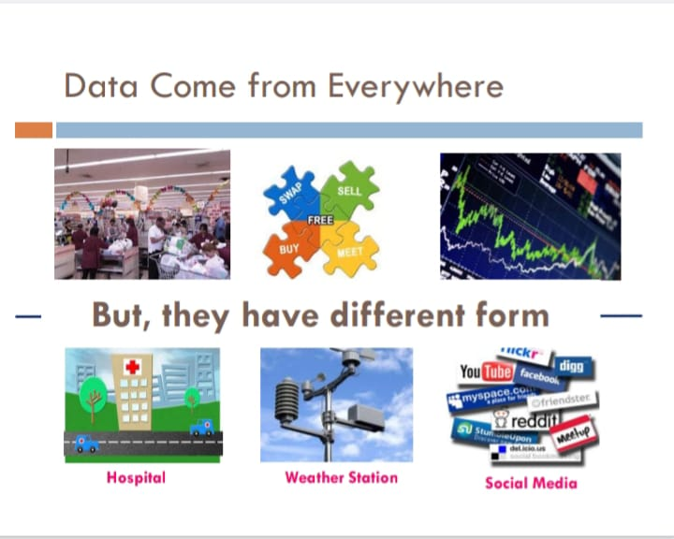

Slide 4
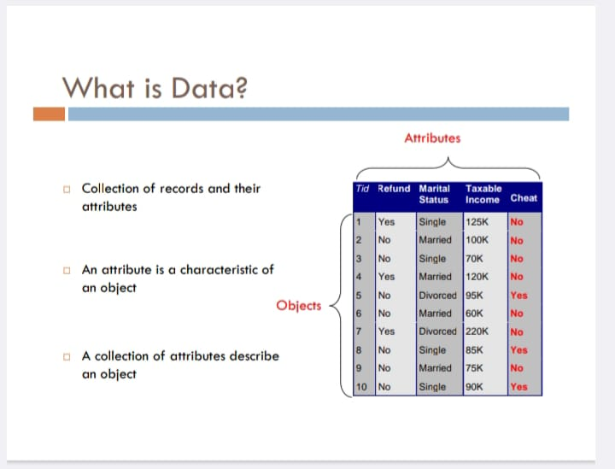

Slide 5
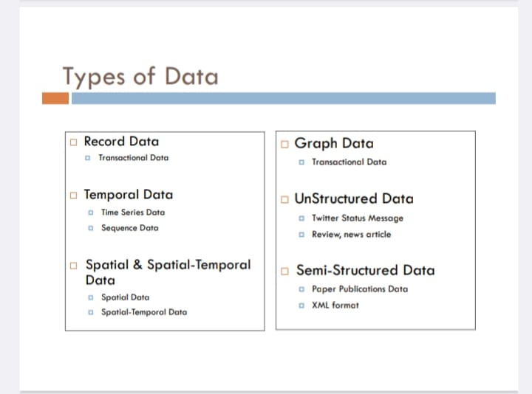

Slide 6
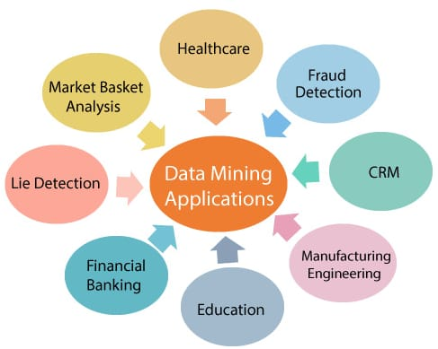
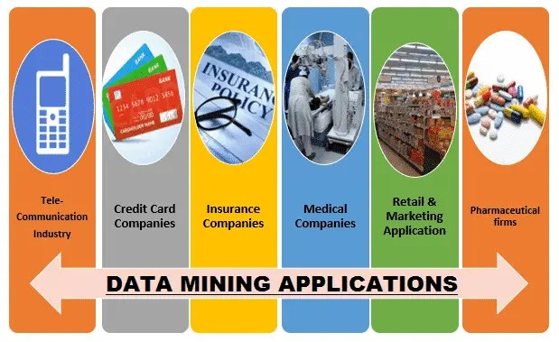

Slide 7
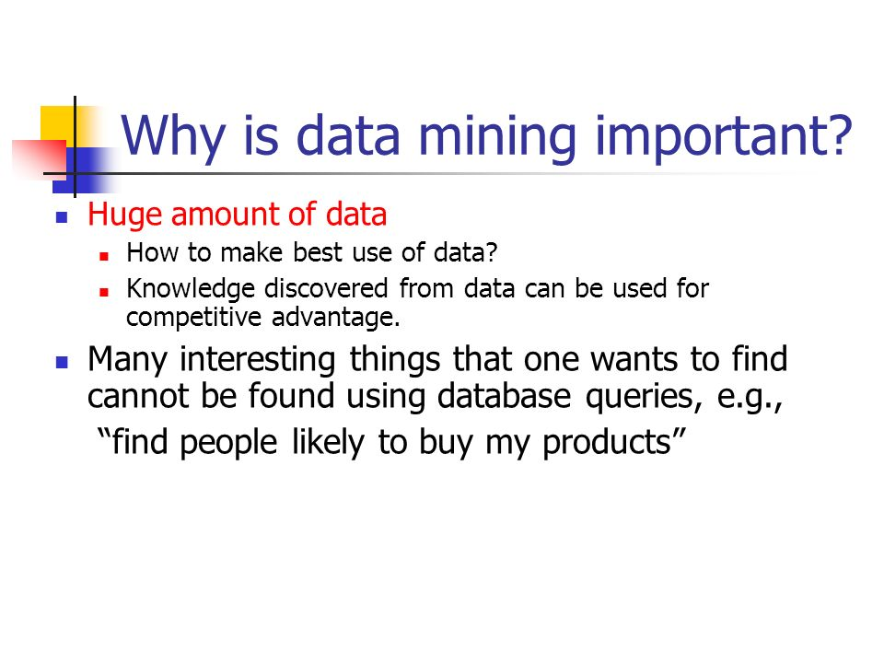

Slide 8
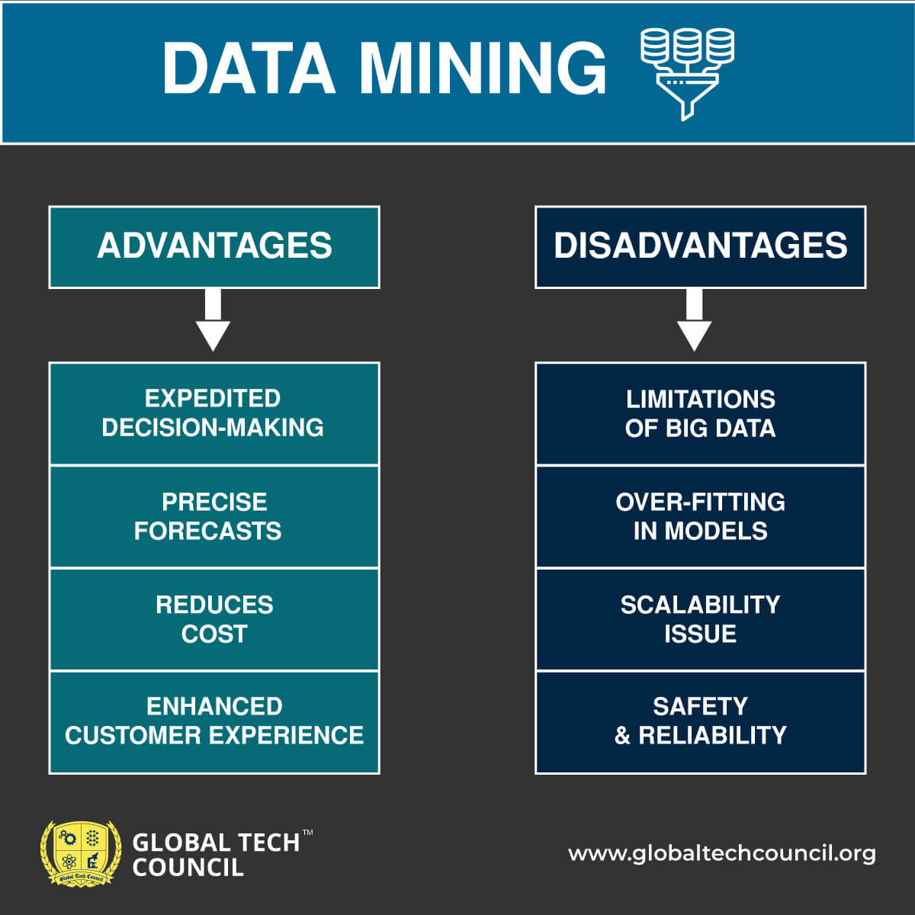
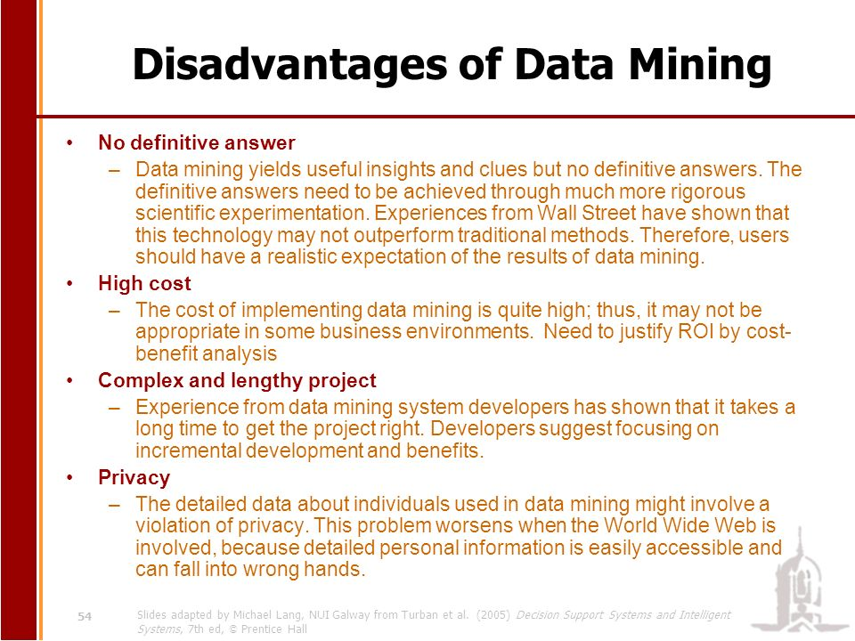

Slide 9
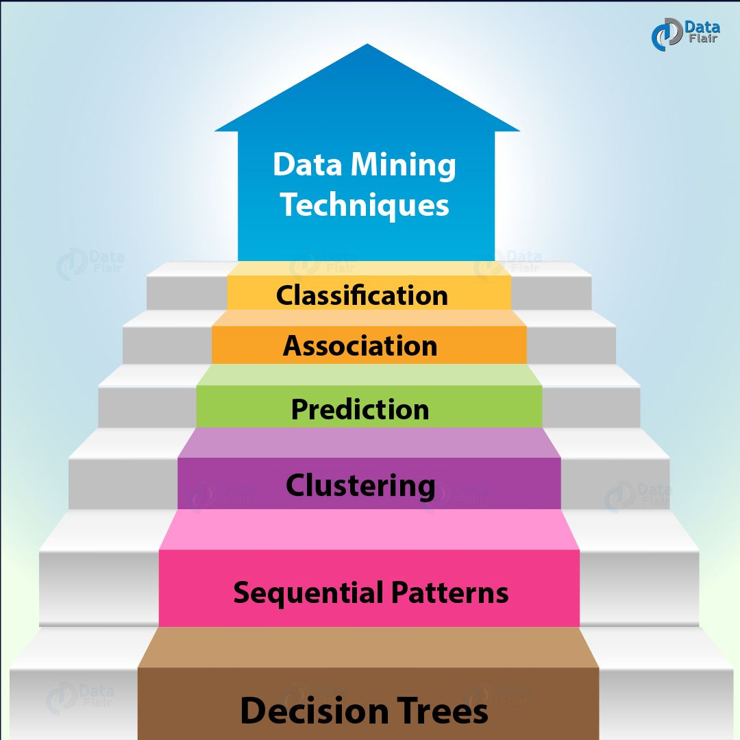
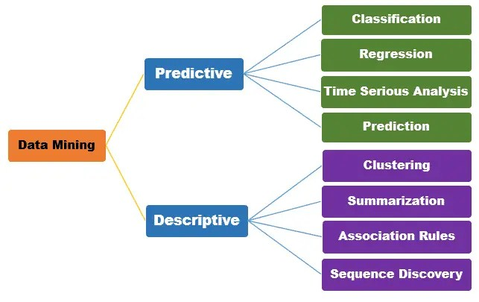

Slide 10

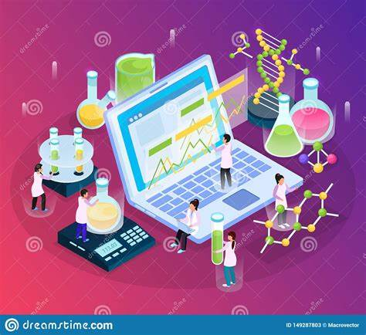

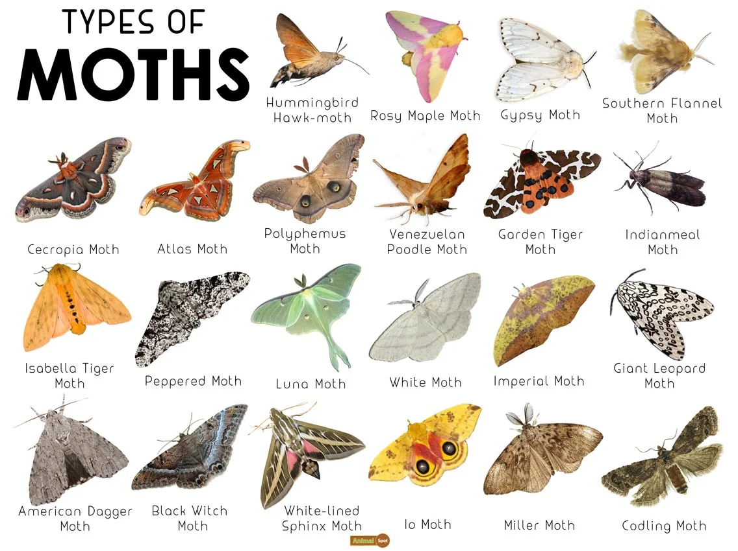
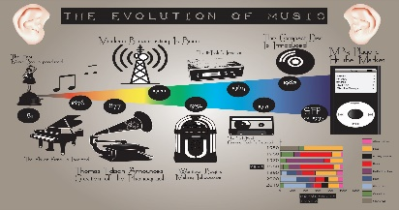
Examples of Classification according to Data Mining:
Email Spam Detection
Medical Diagnosis
Weather Forecasting
Species Identification
Music Genre Classification

Slide 11
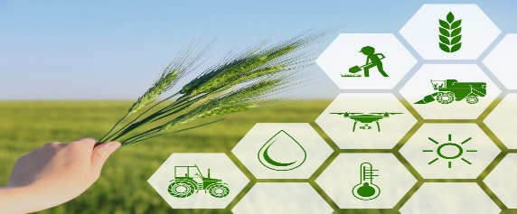


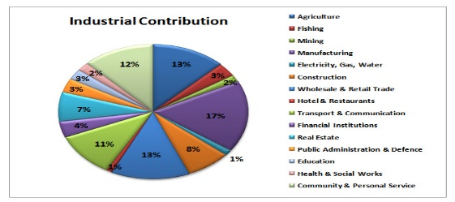
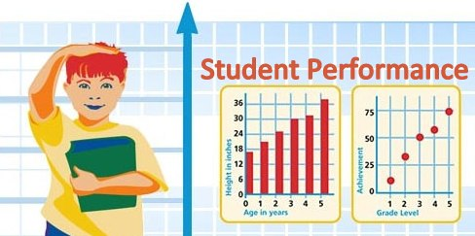
Examples of Regression for Data Mining Issues:
Crop yield estimation
House price prediction
Stock Price prediction
GDP growth prediction
Student performance prediction

Slide 12

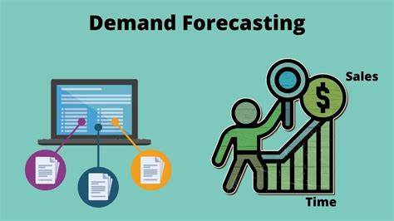
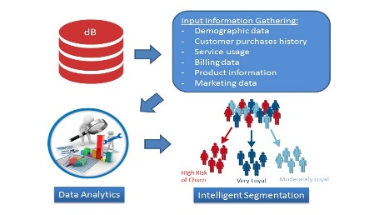
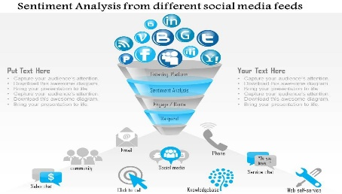

Examples of prediction according to Data Mining:
Fraud Detection
Demand Forecasting
Customer Churn Prediction
Social Media Sentiment Analysis
Personalized Recommendations

Slide 13
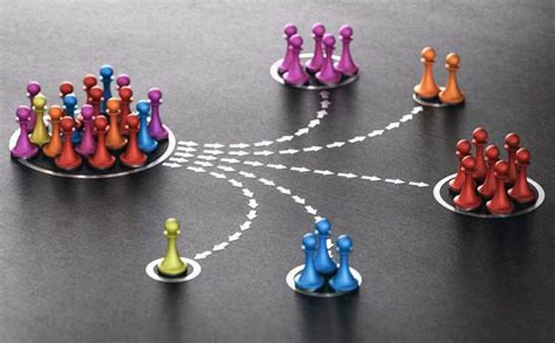
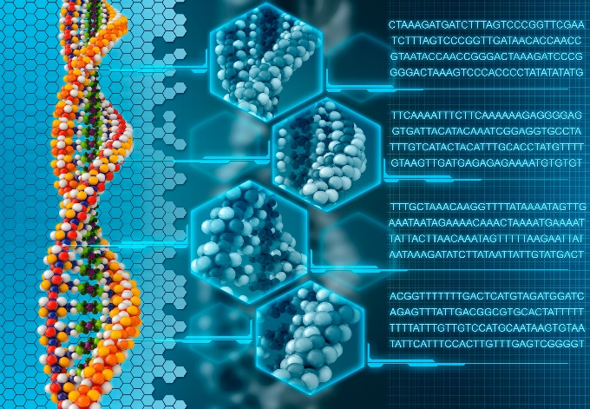
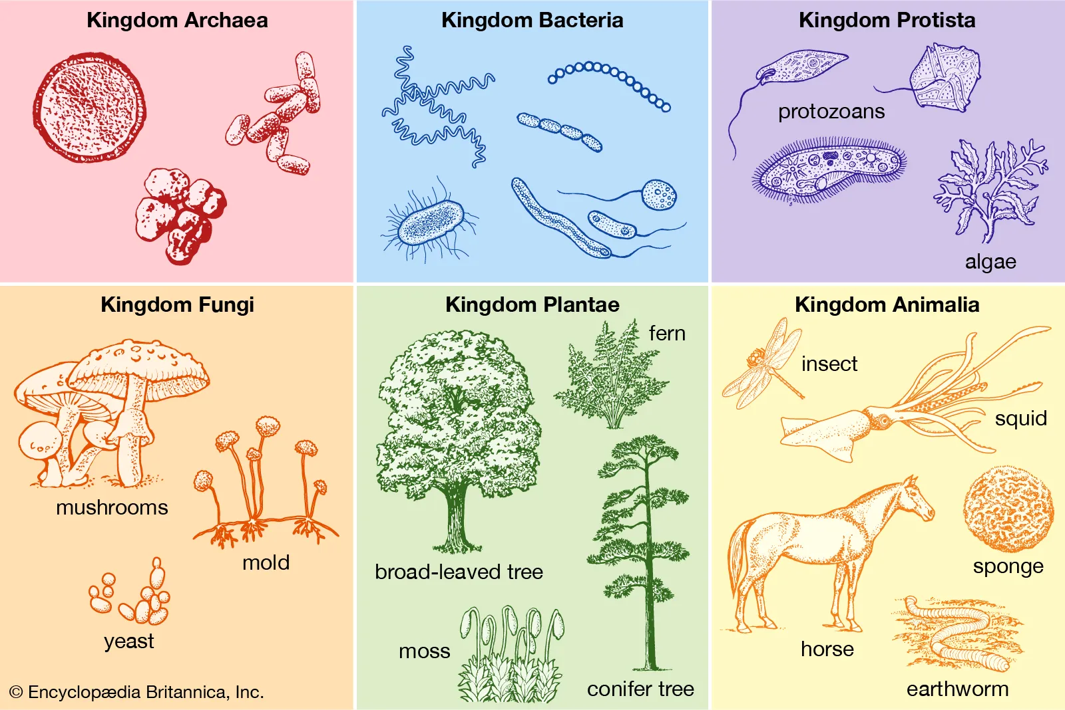
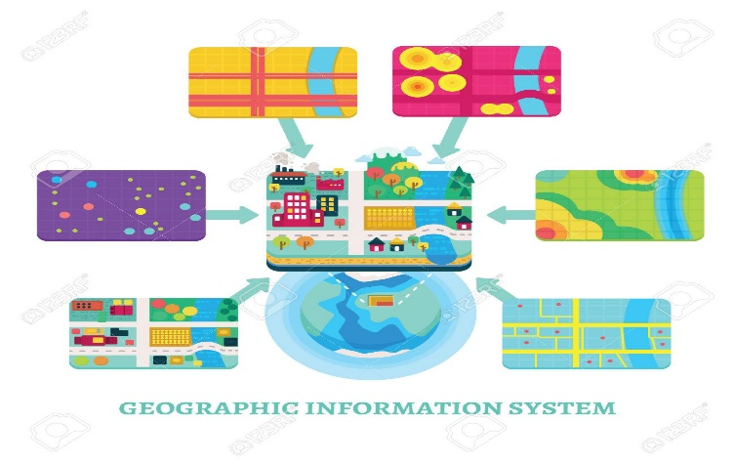

Examples of clustering according to Data Mining used in several fields:
Genomic Data Analysis
Customer Segmentation
Biological Taxonomy
Recommendation Systems
Geographical Data Analysis

Slide 14
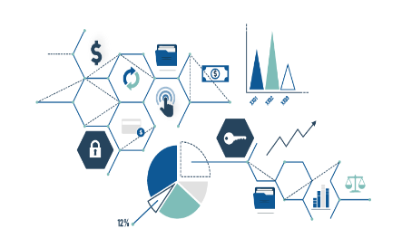
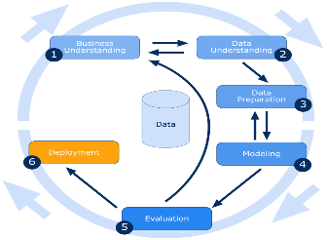

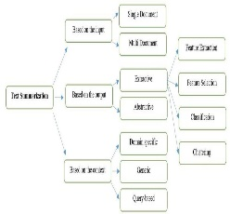
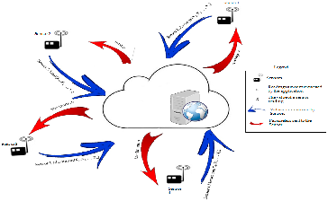
Examples of Summarization according to Data Mining:
Text Document Summarization
Image Data Summarization
Healthcare Data Summarization
Sensor Data Summarization
Web Page Summarization

Slide 15





Examples of Association Rules according to Data Mining:
Market Basket Analysis
Website Navigation Analysis
Inventory Management
Environmental Monitoring
Online Add Targeting

Slide 16


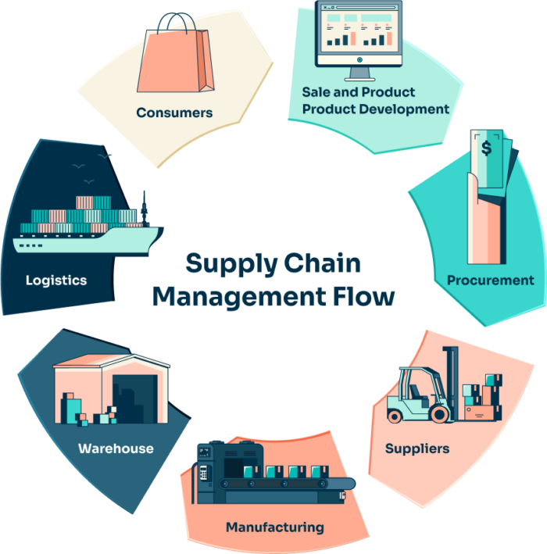
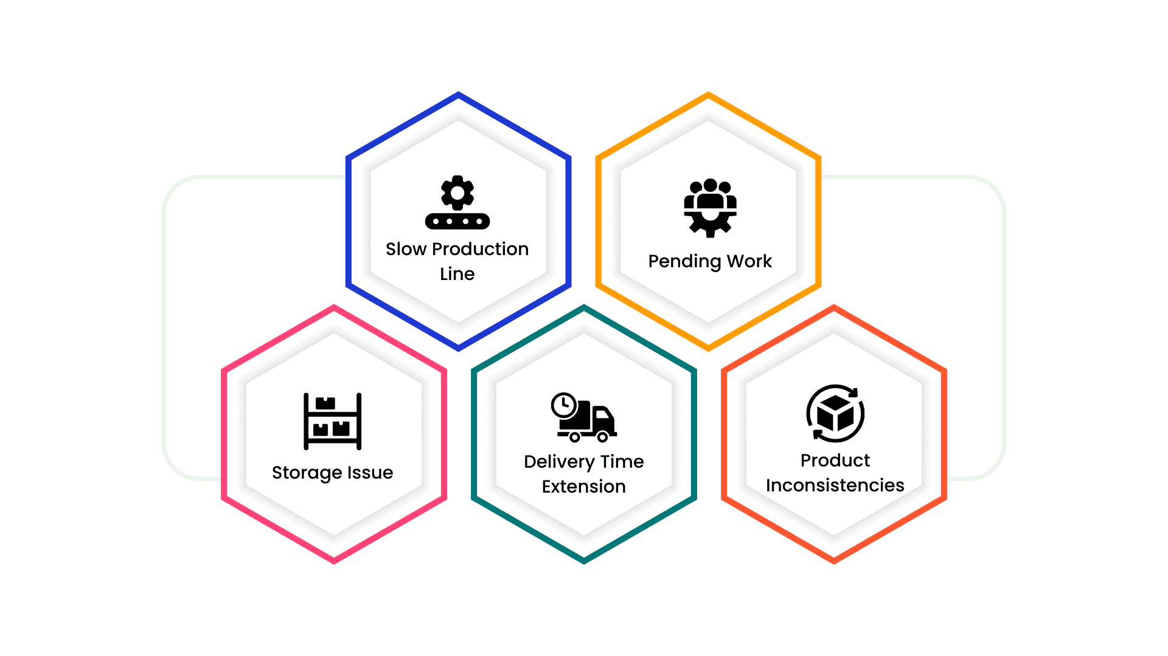
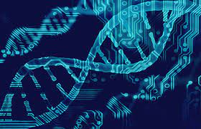
Examples of Sequence Discovery according to data mining:
Web User Clickstreams
Healthcare and Medical Records
Manufacturing Process Optimization
Genomic Sequences

Slide 17
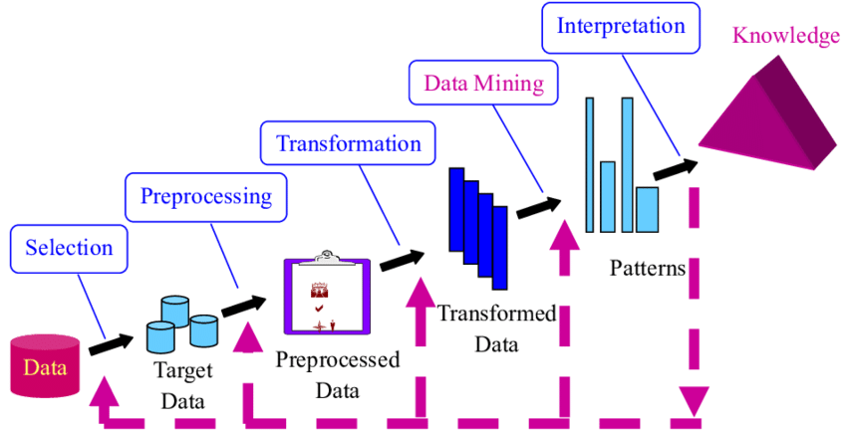
The KDD process consists of the following five steps:

Slide 18
The Development of Data Mining
The current evolution of data mining functions and products is the result of years of influence from many disciplines, including databases, information retrieval, statistics, algorithms, and machine learning.
Information retrieval
Statistics
Databases
Algorithms
Machine learning

Slide 19
Thank You

